Slide 1
Canteen Management System
We are group 3

Slide 2
Table of contents
01
02
03
04
About teams
Function
Database design
Achieved and restricted
05
Demo

Slide 3
01
About teams

Slide 4


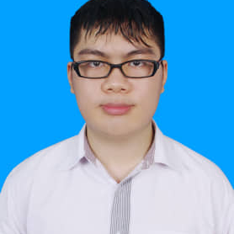
Our team
Ho Gia Huy
Pham Hai Hung
Duong Van Hoang
Leader
Member
Member

Slide 5
02
Function
02
Function

Slide 6
1. View
Product
Category
Customer
Order
Staff
Income
2. Subjects manage:
Edit
Add
Delete
3. Employer/Employee manage:
Employer:
Add customer, product
Edit customer, product, your account, income
Delete customer, account staff
Order product, choose customer
View all income of staff
View order revenue
Employee:
Order product
View only your income
Choose customer, edit and delete customer
Edit your account

Slide 7
03
Database design

Slide 8
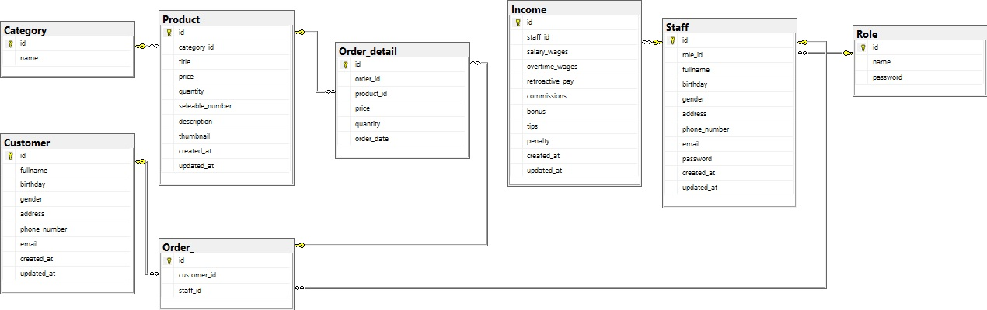

Slide 9
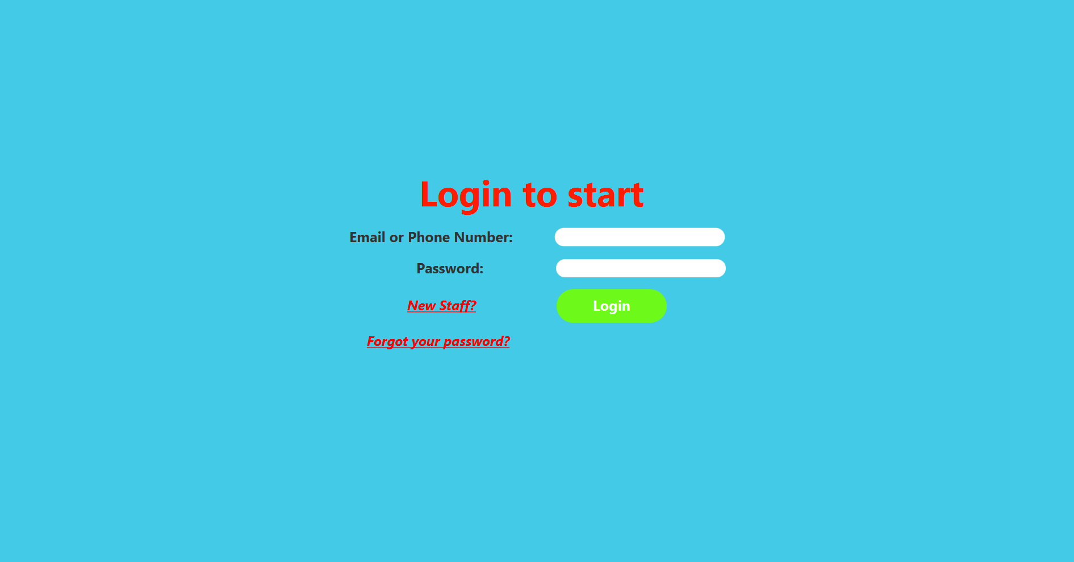
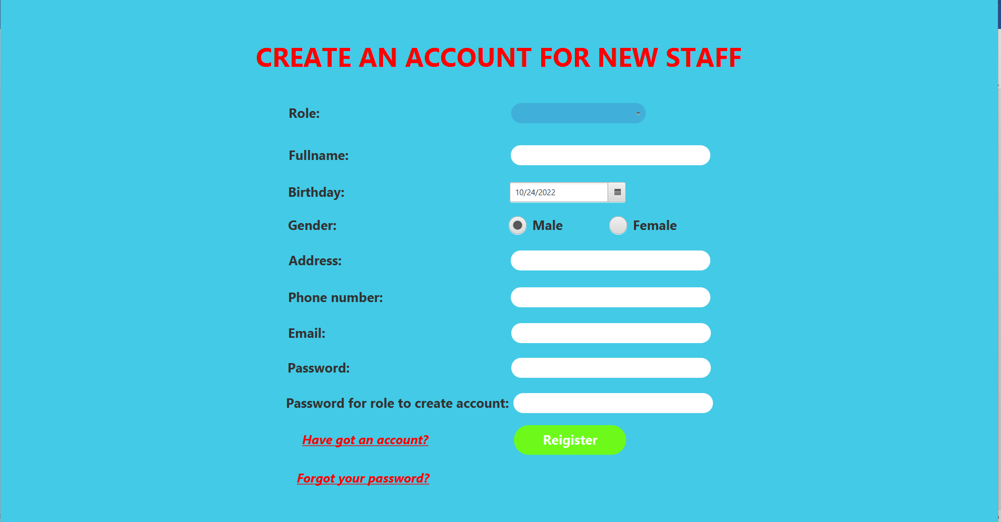
Login
Register

Slide 10
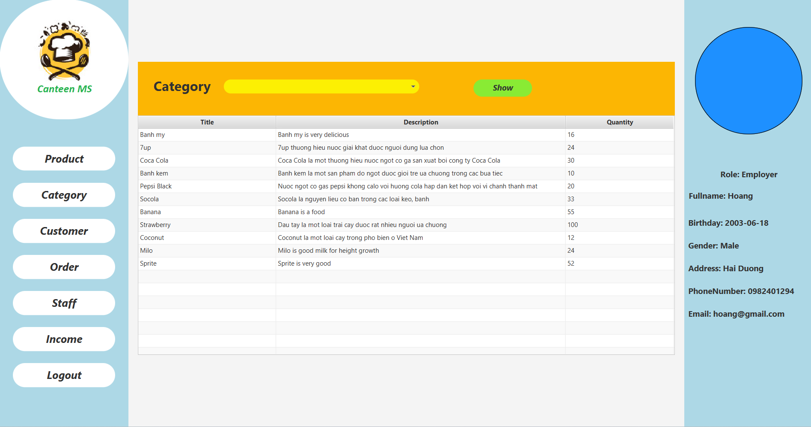
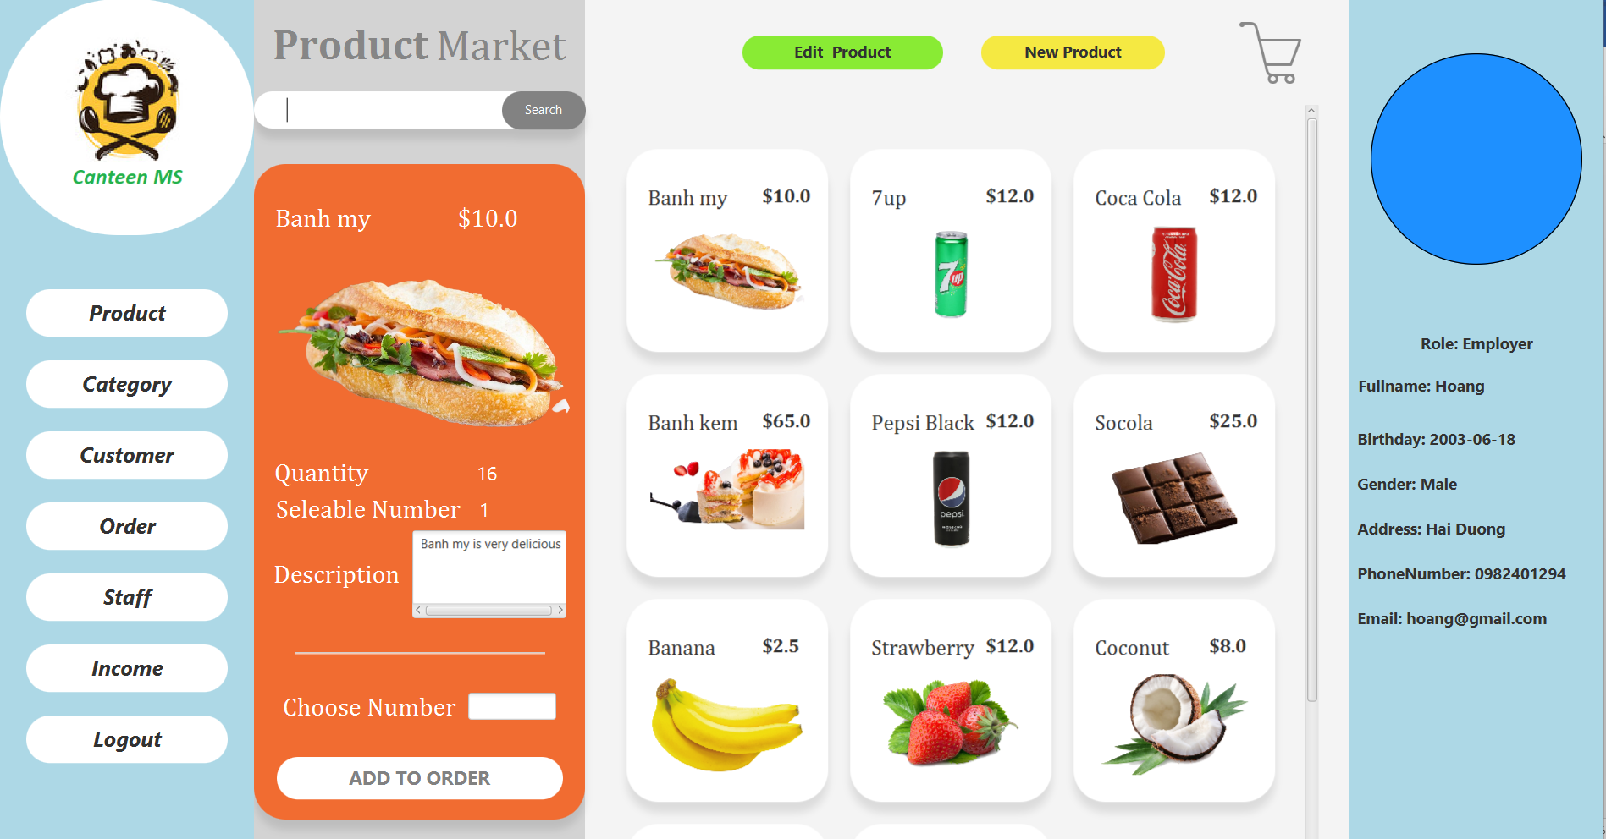
Category
Product

Slide 11
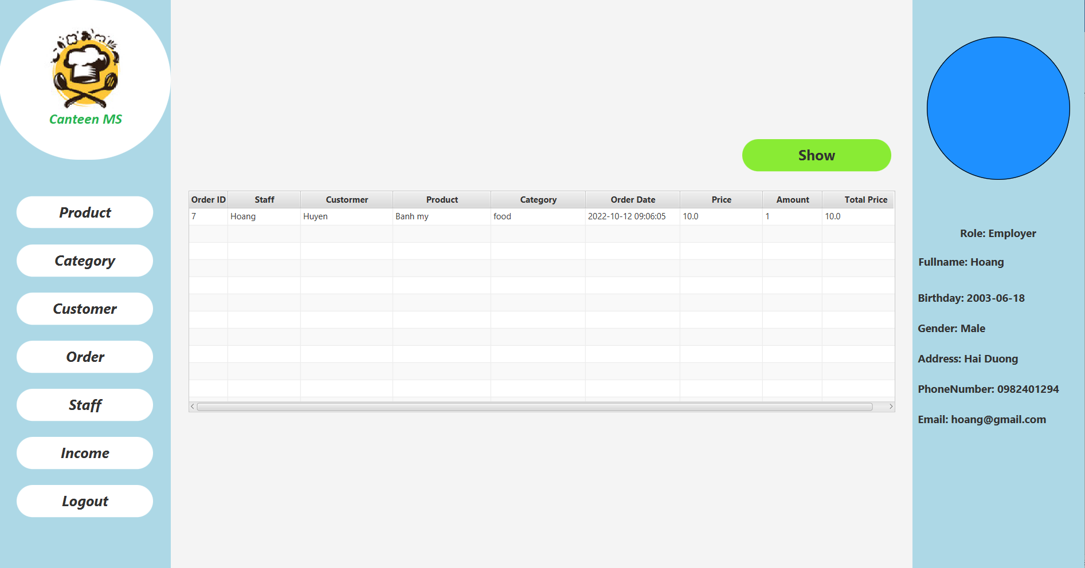
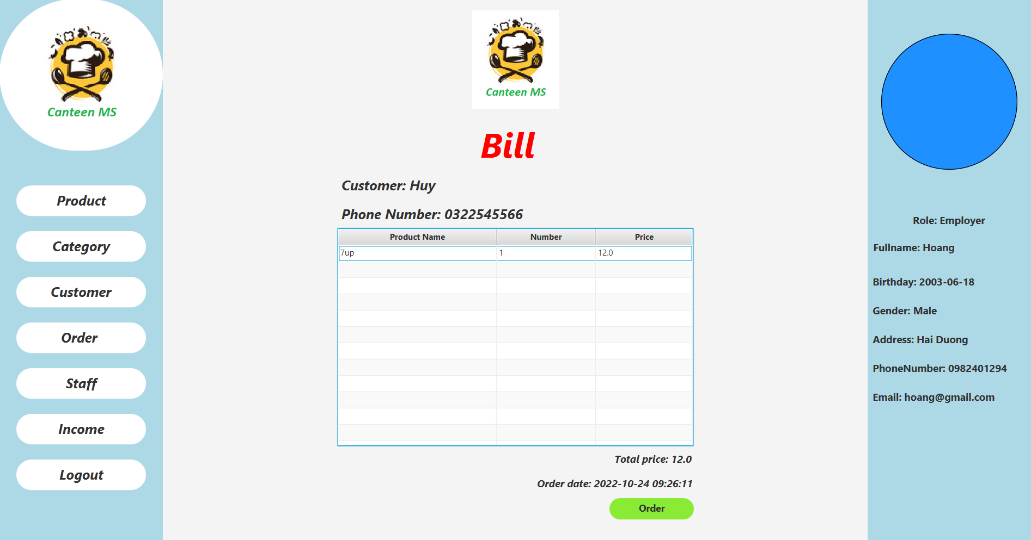
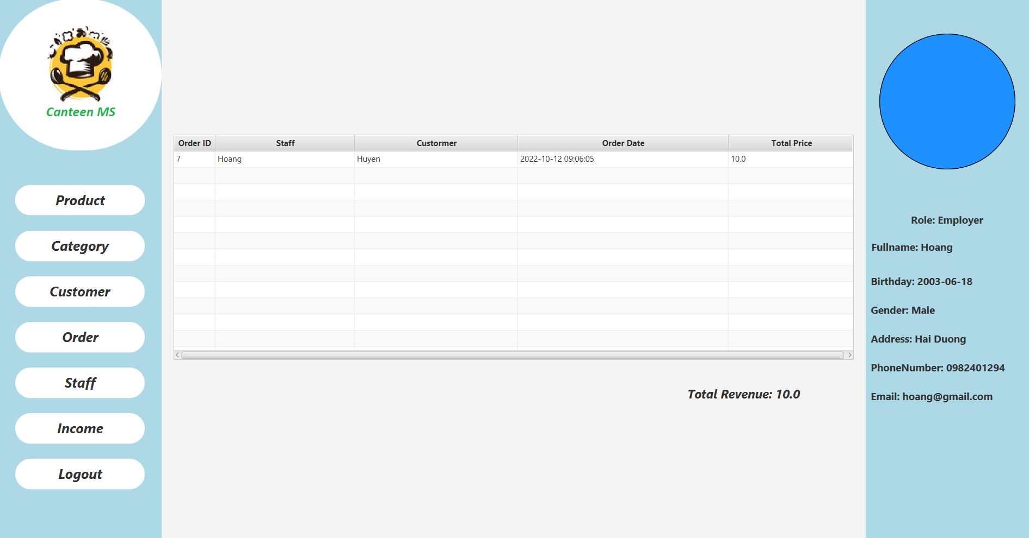
Order Detail
Bill
Order Revenue

Slide 12
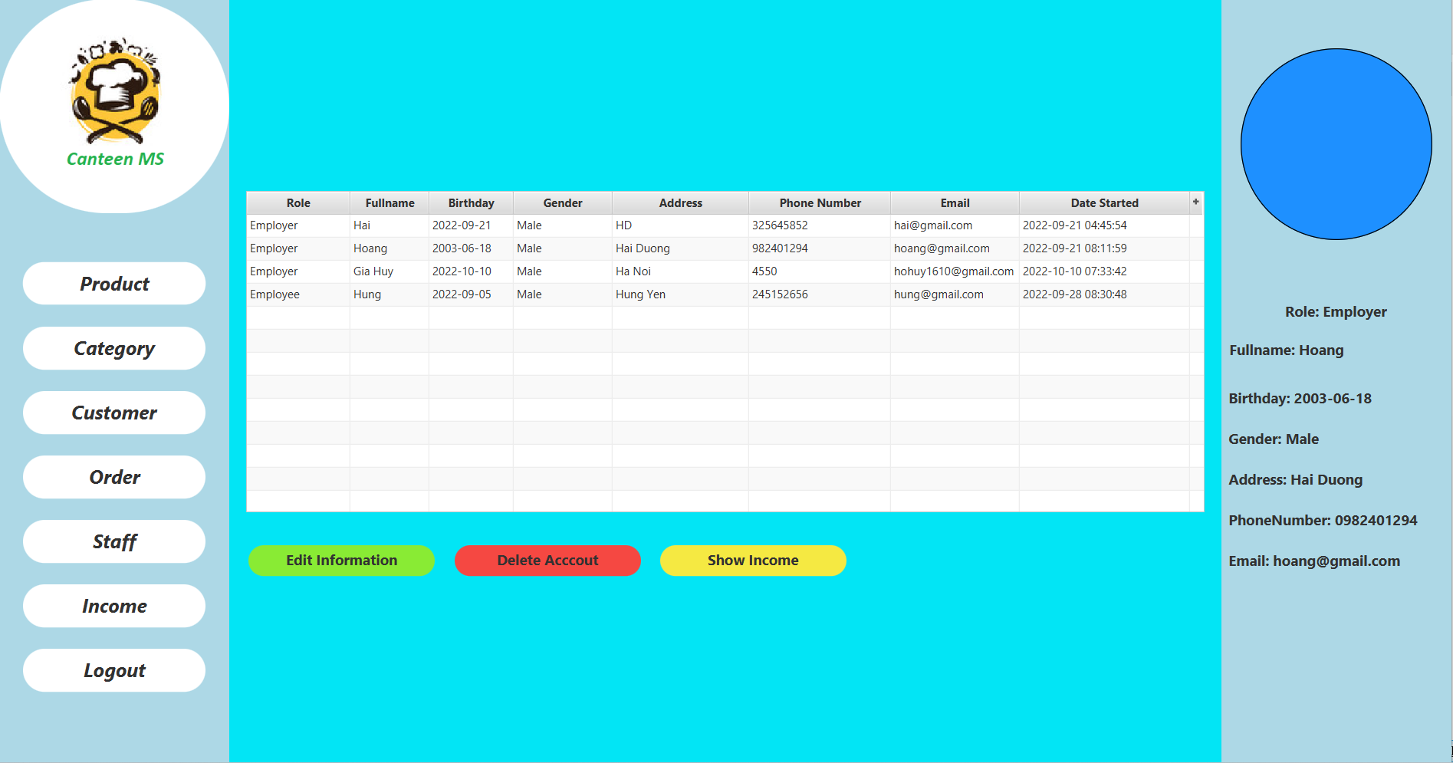
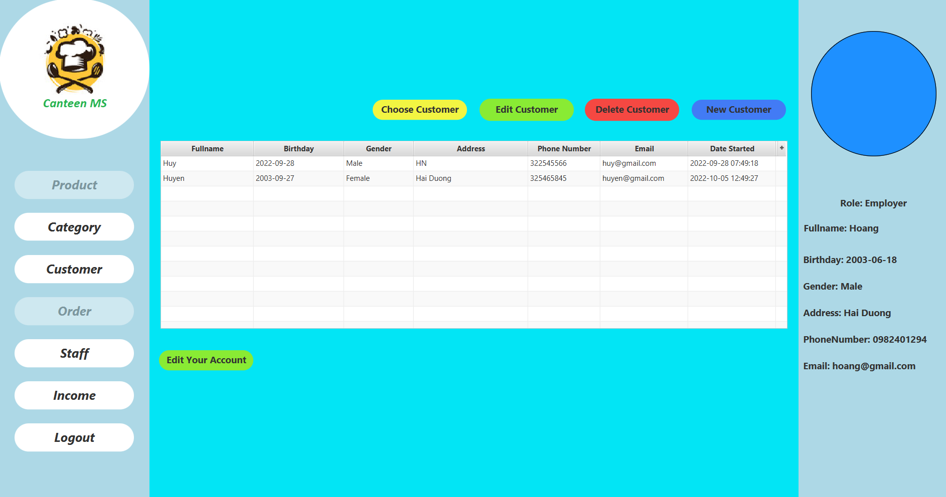
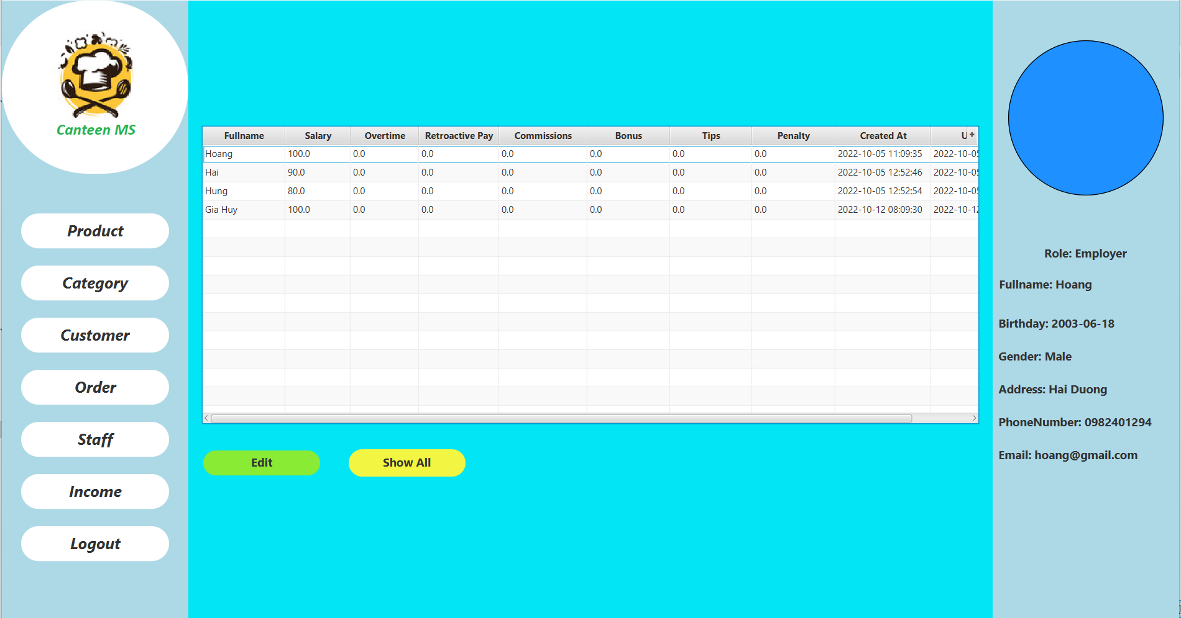
Staff
Customer
Income

Slide 13
04
Achieved and restricted

Slide 14
Achieved
- Added, edit and delete functions have been done.
- The product interface as well as other interfaces is stable and user-friendly.

Slide 15
Restricted
- The function of resetting the account password when forgotten has not been done yet.
- The product by name could not be found.
- The item No is still not available in the tables.
- Can't add photos by directly selecting images, but you have to fill in the image link from the folder.

Slide 16
05
Demo

Slide 17
Thanks!
Do you have any questions?
hohuy1610@gmail.com
ht2137559@gmail.com

